Slide 1
Automated Student Attendance Monitoring and Analytics System for Colleges
SIH25016 - Capstone Project Review-2
Batch Number:ISE_6
Under the Supervision of,
Ms.Jijina M T
Assistant Professor
School of Computer Science and Engineering
Presidency University
Roll Number | Student Name
20221ISE0030 20221ISE0033 20221ISE0007 | Tarun S Gopi Krishna Abinaya K
Name of the Program: ISE
Name of the HoD: Dr.Zafar Ali Khan N
Name of the Program Project Coordinator: Ms.Suma N G
Name of the School Project Coordinators: Dr. Sampath A K , Dr. Geetha A

Slide 2
Problem Statement Number: SIH25016
Organization: Educational Institutions
Category :Software
Problem Description:
In many colleges, student attendance is still managed manually or through semi-digital systems. These methods are time-consuming, prone to human error, and allow proxy attendance. Faculty members spend valuable classroom time recording attendance, and management lacks real-time insights into attendance trends. There is no centralized system that efficiently monitors attendance while also providing analytical reports to support academic decision-making. This creates inefficiency, lack of transparency, and difficulty in improving student engagement.

Slide 3
Content
Objectives:
To automate the student attendance process using a software system
To reduce manual work and eliminate proxy attendance
To provide real-time attendance monitoring
To generate attendance analytics for students, faculty, and management
To improve academic planning and student performance
To support digital transformation in education

Slide 4
Analysis of Problem Statement:
Manual attendance consumes classroom time
Attendance records are difficult to manage for large student groups
Lack of centralized and real-time data
No predictive or analytical insights available
Students are unaware of attendance shortages until exams
Existing systems do not focus on analytics and decision support

Slide 5
Analysis of Problem Statement
Current Gaps:
Manual and semi-digital attendance leads to errors and proxy attendance
No real-time monitoring or instant access to attendance data
Lack of analytical reports for academic decision-making
Technical Needs:
Automated, web-based attendance management system
Secure login with role-based access control
Analytics and visualization tools for attendance insights

Slide 6
Innovation or Novel Contributions.
Real-time attendance analytics instead of simple record keeping
Role-based dashboards for Admin, Faculty, and Students
Early warning system for low attendance
Visual analytics using graphs and trends
Scalable and customizable for different institutions
Supports data-driven decision-making in education

Slide 7
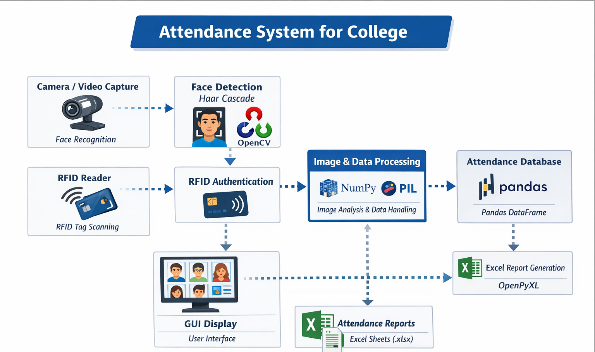
College attendance system workflow diagram

Slide 8
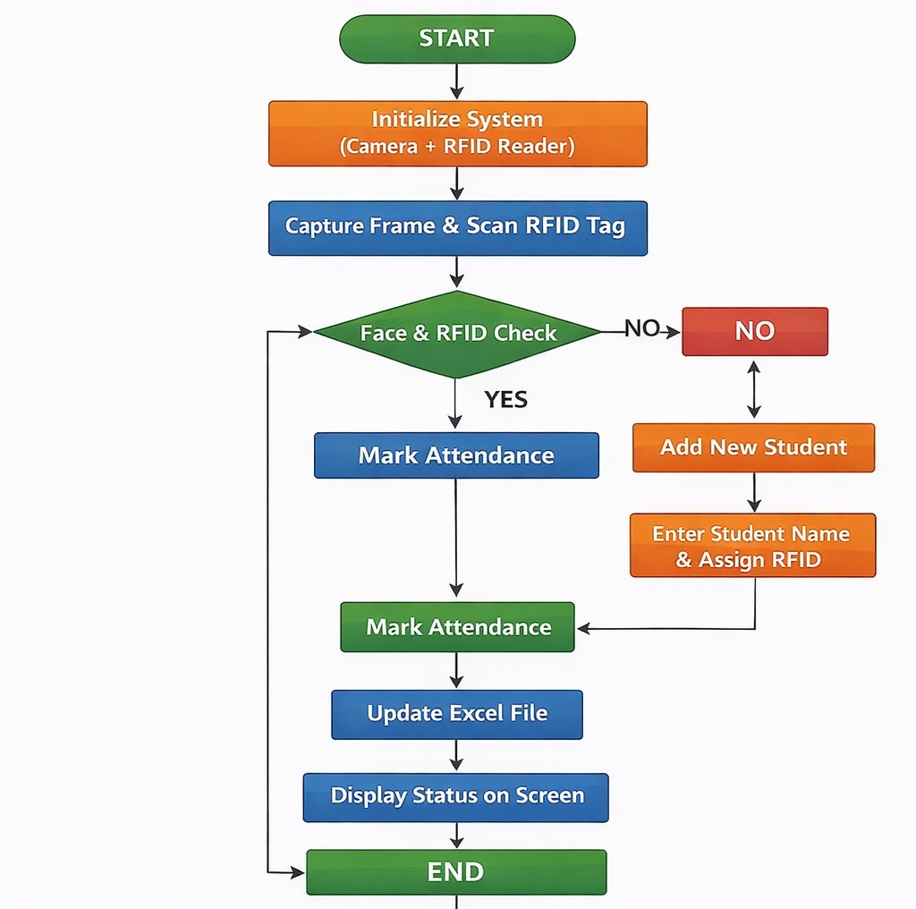
Student attendance flowchart illustration

Slide 9
Github Link
The Github link provided should have public access permission.
Github Link

Slide 10
Analysis of Problem Statement (contd...)
Software and Hardware Requirements:
Operating System: Windows 10 / 11 or Linux
Frontend Technologies: HTML, CSS, JavaScript
Backend Technologies: Python
Libraries & Frameworks:
OpenCV (opencv-python)
Camera/video capture,Face detection (Haar Cascade),Image processing
NumPy
Numerical operations,Array handling for images
Pandas
Data organization,Creating DataFrames for attendance
OpenPyXL
Creating Excel files (.xlsx)
Pillow (PIL)
Image processing,Converting images for GUI display

Slide 11
References (IEEE Paper format)
[1] “Real-Time Student Face Recognition Attendance System using AI,” IARJSET, 2025. [Online]. Available: https://iarjset.com/wp-content/uploads/2025/05/IARJSET.2025.125183.pdf
[2] “Automated Attendance and Analytics System,” IJRASET, 2025. [Online]. Available: https://www.ijraset.com/research-paper/automated-attendance-and-analytics-system
[3] N. S. Ali, H. M. Ali, & N. B. M. Yusof, “Automated Attendance Management Systems: Systematic Literature Review,” ResearchGate, 2025. [Online]. Available: https://www.researchgate.net/publication/358178607_Automated_attendance_management_systems_systematic_literature_review
[4] N. R. Ghadge, S. D. Bagul, S. S. Raut & P. R. Raut, “Automated Student Monitoring and Attendance System,” IJRTI, 2025. [Online]. Available: https://www.ijrti.org/papers/IJRTI2505282.pdf
[5] A. Osman, A. Elshaer, et al., “An Automatic Student Attendance Monitoring System using Face Recognition,” IET Smart Systems, vol. 4, no. pp, 2024. Available: https://www.iieta.org/journals/ts/paper/10.18280/ts.400234

Slide 12
References (IEEE Paper format)
[6] A. Abraham, S. Stephen & R. P. Nair, “Face Recognition Based Attendance System,” ResearchGate, 2020. Available: https://www.researchgate.net/publication/363214601_Face_Recognition_Based_Attendance_System
[7] R. Patel & A. Shah, “Face Recognition Based Attendance Management System,” ResearchGate, 2021. Available: https://www.researchgate.net/publication/341876647_Face_Recognition_based_Attendance_Management_System
[8] N. Kumar & M. Singh, “Smart Attendance Management System Using Face Recognition,” ResearchGate, 2018. Available: https://www.researchgate.net/publication/334820129_Smart_Attendance_Management_System_Using_Face_Recognition
[9] M. M. Khan & J. M. Ahmad, “Automatic Attendance System using Face Detection and Recognition,” IJNRD, 2024. Available: https://www.ijnrd.org/papers/IJNRD2402032.pdf
[10] A. Joshi, R. Kumar & K. Choudhary, “RFID Based Attendance System,” ResearchGate, 2021. Available: https://www.researchgate.net/publication/348253883_RFID_Based_Attendance_System

Slide 13


